Slide 1
Operating Systems

Slide 2
Outline
What is OS? What does it do?
History of OS
Computer Hardware Review
OS Major Components
OS Structure
Summary

Slide 3
What Is an OS?
“Code” that:
Sits between programs & hardware
Sits between different programs
Sits betweens different users
But what does it do?
to provide an orderly and controlled allocation of the processors, memories and I/O devices among the various programs competing for them
Real Life Example:
Government

Slide 4
What Is an OS?
Resources
Allocation
Protection
Reclamation
Virtualization
Services
Abstraction
Simplification
Convenience
Standardization
Makes computers simpler

Slide 5
What Is an OS?
Government
Limited budget,
Land,
Oil,
Gas,
Resources
Allocation
Protection
Reclamation
Virtualization
Finite resources
Competing demands
Examples:
CPU
Memory
Disk
Network

Slide 6
What Is an OS?
Government
Law and order
Resources
Allocation
Protection
Reclamation
Virtualization
You can’t hurt me
I can’t hurt you
Implies some degree of safety & security

Slide 7
What Is an OS?
Government
The OS gives
The OS takes away
Voluntary at run time
Implied at termination
Involuntary
Cooperative
Income Tax
Resources
Allocation
Protection
Reclamation
Virtualization

Slide 8
What Is an OS?
Government
Social security
Resources
Allocation
Protection
Reclamation
Virtualization
illusion of infinite, private resources
Memory versus disk
Timeshared CPU
More extreme cases possible (& exist)

Slide 9
History of Operating Systems (1)
First generation 1945 – 1955
  vacuum tubes, plug boards (no OS)
Second generation 1955 – 1965
  transistors, batch systems
Third generation 1965 – 1980
  ICs and multiprogramming
Fourth generation 1980 – present
  personal computers, hand-held devices, sensors

Slide 10

History of Operating System (1945-55)
Early batch system
  bring cards to 1401
  read cards to tape
  put tape on 7094 which does computing
  put tape on 1401 which prints output

Slide 11
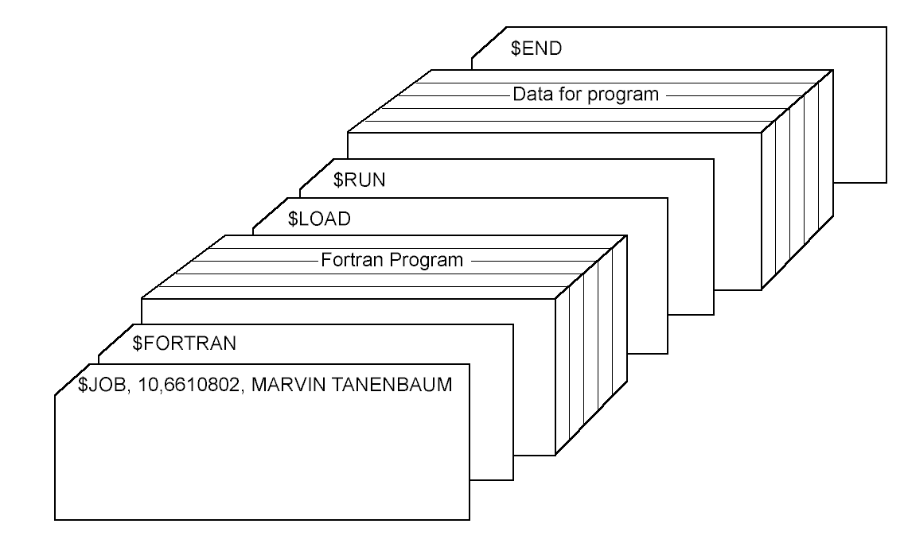
History of Operating Systems
(1955-65)
Structure of a typical JCL job – 2nd generation
Single user
Programmer/User as the operator
Secure, but inefficient use of expensive resources
Low CPU utilization-slow mechanical I/O devices

Slide 12

History of Operating Systems
(1965-80)
Multiprogramming system
  Three jobs in memory – 3rd generation
  Spooling - use disk as a very large buffer for input/output devices
  Polling/Interrupts, Timesharing

Slide 13
The Operating System Zoo
(1980-present)
Mainframe operating systems
Server operating systems
Multiprocessor operating systems
Personal computer operating systems
Real-time operating systems
Embedded operating systems
Smart card operating systems

Slide 14
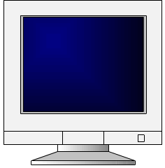
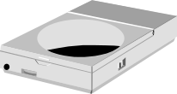

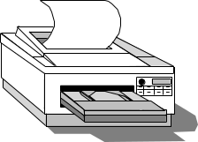

A Typical Computer from a Hardware Point of View
CPU
. . .
CPU
Memory
Chipset
I/O bus
Network

Slide 15
Typical Computer System
Memory
CPU
Programs and data
.
.
.
Operating System Software
CPU
OS
Network
Apps
Data

Slide 16
Processors
Each CPU has a specific set of instructions
All CPUs contain
  General registers to hold key variables and temporary results
  Special registers visible to the programmer
    Program counter contains the memory address of the next instruction to be fetched
    Stack pointer points to the top of the current stack in memory
    PSW (Program Status Word) contains the condition code bits which are set by comparison instructions, the CPU priority, the mode (user or kernel) and various other control bits.

Slide 17
How Processors Work
Execute instructions
  CPU cycles
    Fetch (from mem) → decode → execute
    Program counter (PC)
      When is PC changed?
    Pipeline: fetch n+2 while decode n+1 while execute n
  Two modes of CPU (why?)
    User mode (a subset of instructions)
    Privileged mode (all instruction)
  Trap (special instruction)

Slide 18
Memory Access
Memory read:
  Assert address on address lines
  Wait till data appear on data line
  Much slower than CPU!
How many mem access for one instruction?

Slide 19
Memory Access
Memory read:
  Assert address on address lines
  Wait till data appear on data line
  Much slower than CPU!
How many mem access for one instruction?
  Fetch instruction
  Fetch operand (0, 1 or 2)
  Write results (0 or 1)
How to speed up instruction execution?

Slide 20
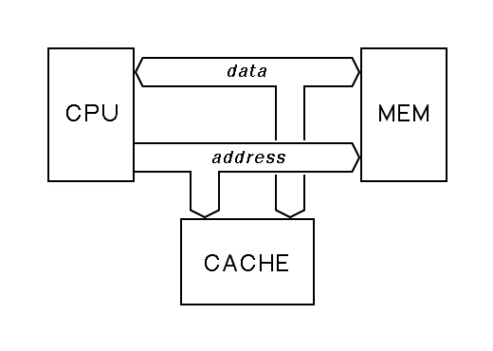
CPU Cache
Cache hit:
  no need to access memory
Cache miss:
  data obtained from mem, possibly update cache

Slide 21
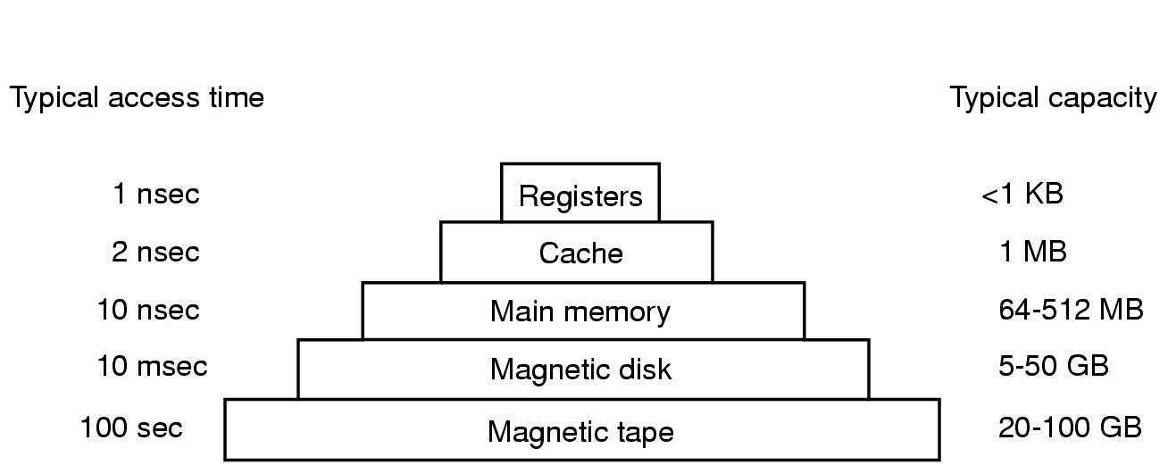
Memory-Storage Hierarchy
<
- 4MB
-1GB
2GB- 1TB
-TB

Slide 22
Memory Management
How to protect programs from each other?
How to handle relocation ?
Base register
Limit register
Check and Mapping of Addresses
  Virtual Address - Physical Address
  Memory Management Unit (MMU – located on CPU chip or close to it
Performance effects on memory system
  Cache
  Context switch

Slide 23
I/O Devices
Controller
  Controllers is a chip which converts OS request into device parameters
  Example: Disk Controller
  Controllers often contain small embedded computers

Slide 24
I/O Devices
Device Driver
  Software that talks to a controller, giving it comments and accepting responses
  Each controller manufacturer supplies a driver for each OS it supports (e.g., drivers for Windows XP, Longhorn, UNIX)

Slide 25
Methods for I/O
How device driver talks to controller
  Busy wait
  Interrupt
  DMA

Slide 26

Structure of a Large Pentium System

Slide 27
OS Major Components
Process and thread management
Resource management
  CPU
  Memory
  Device
File system
Bootstrapping

Slide 28

Process: a running program
A process includes
  Address space
  Process table entries (state, registers)
A process tree
  A created two child processes, B and C
  B created three child processes, D, E, and F

Slide 29
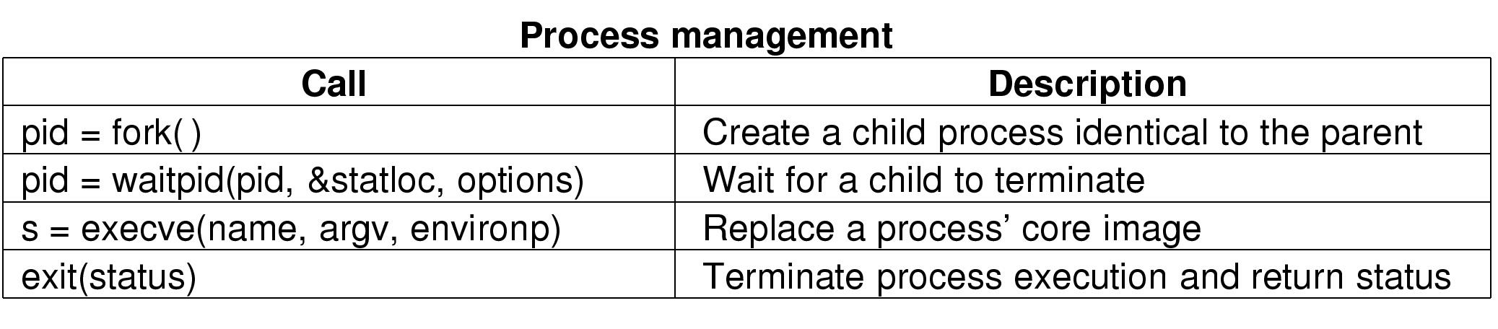
Some System Calls For Process Management

Slide 30
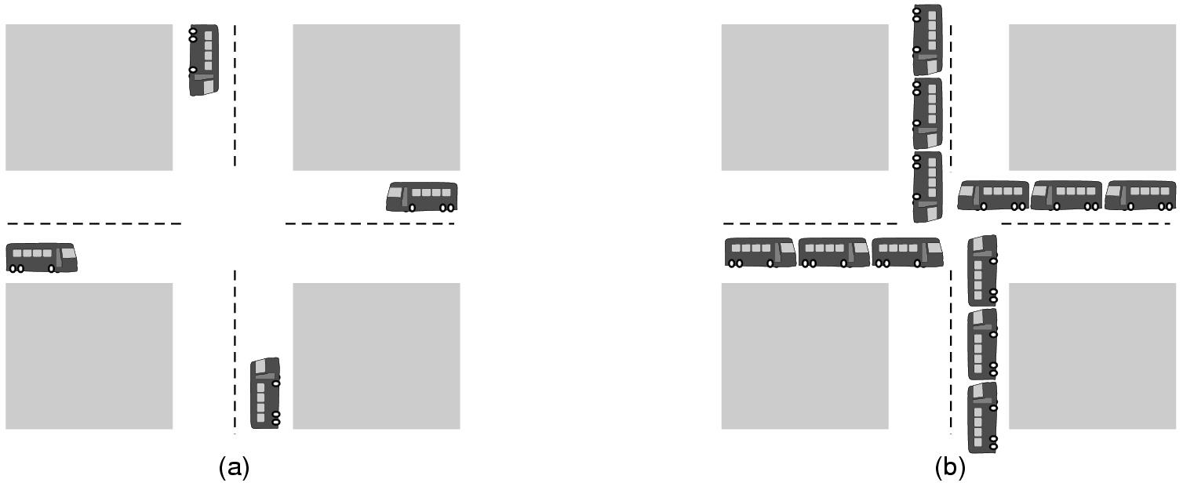
Deadlock
(a) A potential deadlock. (b) an actual deadlock.

Slide 31
File System
A typical file system
  Open a file with authentication
  Read/write data in files
  Close a file
Can the services be moved to user level?
User 1
User n
. . .
File system services
File
File
. . .

Slide 32
Bootstrapping
Power up a computer
Processor reset
  Set to known state
  Jump to ROM code
Load in the boot loader from stable storage
Jump to the boot loader
Load the rest of the operating system
Initialize and run
Boot
loader
Boot
loader
OS
sector 1
OS
sector 2
.
.
.
OS
sector n

Slide 33
From Slide What is OS
Code that:
  Sits between programs & hardware
  Sits between different programs
  Sits betweens different users
Job of OS:
  Manage hardware resources
    Allocation, protection, reclamation, virtualization
  Provide services to app.
    Abstraction, simplification, standardization
Application
OS
Hardware

Slide 34
Quiz
What is an operating system?
Briefly discuss the history and evolution of Operating System.
Explain the purpose of cache.
What is bootstrapping?
CS 423 - Fall 2007

Slide 35
From Slide What is OS
Code that:
  Sits between programs & hardware
  Sits between different programs
  Sits betweens different users
Job of OS:
  Manage hardware resources
    Allocation, protection, reclamation, virtualization
  Provide services to app. How? -- System Call
    Abstraction, simplification, standardization
Application
OS
Hardware

Slide 36
A peek into Unix/Linux
Application
Libraries
User space/level
Portable OS Layer
Kernel space/level
Machine-dependent layer
User/kernel modes are
supported by hardware
Some systems do not have
clear user-kernel boundary

Slide 37
Unix: Application
Application
(E.g., emacs)
  Written by programmer
  Compiled by programmer
  Uses function calls
Libraries
Portable OS Layer
Machine-dependent layer

Slide 38
Unix: Libraries
Application
  Provided pre-compiled
  Defined in headers
  Input to linker (compiler)
  Invoked like functions
  May be “resolved” when program is loaded
Libraries (e.g., stdio.h)
Portable OS Layer
Machine-dependent layer

Slide 39
Typical Unix OS Structure
Application
Libraries
Portable OS Layer
Machine-dependent layer
  system calls (read, open..)
  All “high-level” code

Slide 40
Typical Unix OS Structure
Application
  Bootstrap
  System initialization
  Interrupt and exception
  I/O device driver
  Memory management
  Kernel/user mode switching
  Processor management
Libraries
Portable OS Layer
Machine-dependent layer

Slide 41

Steps in Making a System Call
Example:
read (fd, buffer,nbytes)

Slide 42
System Calls (POSIX)
System calls for process management
Example of fork used in simplified shell program
  #define TRUE 1
  while(TRUE) {
  type_prompt();
  read_command(command, parameters);
  if (fork()!=0) {
  /* some code*/
  waitpid(-1,&status, 0);}
  else {
  /* some code*/
  execve(command, parameters,0);
  } }

Slide 43
System Calls (POSIX)
System calls for file/directory management
  fd=open(file,how,….)
  n=wride(fd,buffer,nbytes)
  s=rmdir(name)
Miscellaneous
  s=kill(pid,signal)
  s=chmod(name,mode)

Slide 44
System Calls (Windows Win32 API)
Process Management
  CreateProcess- new process (combined work of fork and execve in UNIX)
    In Windows – no process hierarchy, event concept implemented
  WaitForSingleObject – wait for an event (can wait for process to exit)
File Management
  CreatFile, CloseHandle, CreateDirectory, …
  Windows does not have signals, links to files, …, but has a large number of system calls for managing GUI

Slide 45
OS Service Examples
Services that need to be provided at kernel level
  System calls: file open, close, read and write
  Control the CPU so that users won’t stuck by running
    while ( 1 ) ;
  Protection:
    Keep user programs from crashing OS
    Keep user programs from crashing each other
Services that can be provided at user level
  Read time of the day

Slide 46
Is Any OS Complete?
(Criteria to Evaluate OS)
Portability
Security
Fairness
Robustness
Efficiency
Interfaces

Slide 47
Design Tradeoffs
All in the kernel (Windows)
  Pros: efficient?
  Cons: difficult to develop new services
All at user level - Nemesis (Cambridge, UK) – only device drivers exist, all other management was done at user level), TinyOS (UCB) – runs on Modes/ Sensors
  Pros: easy to develop new apps
  Cons: protection
Split between user and kernel (Unix/Linux)
  Kernel: display driver and mouse driver
  User: the rest

Slide 48
Summary
Overview of OS components
A peek at Unix
Criteria to evaluate an OS
Design tradeoffs

Slide 49
Quiz
What are the differences between processes and threads?
What is the purpose of process scheduling?
What are the tasks of operating system kernel?
What are the different methods of interprocess communications?
What is meant by the following terms
  Process control block.
  Critical section
  Context switching.
  Deadlock.
  Semaphore.
  Scheduling and scheduler.
  Mutual exclusion
CS 423 - Fall 2007

